Slide 1

E-commerce
By
Most Shadia Islam Shipu - 3871
Tazmim Bhuiyan Shohan - 4126
Toufiqur Rahaman Toufiq - 4134
Nafsim khan Noor – 4133

Slide 2

Introduction
This console-based e-commerce application in C++ allows admins to manage products and customers to place orders. It uses text files for storing data and employs object-oriented programming principles.

Slide 3
Proposed work
This application proposes a modular, OOP-based approach for creating a simple e-commerce system. It separates admin and customer functionality and ensures persistent storage via file operations.

Slide 4
Methodology
1. File I/O for saving/loading data 2. Classes for encapsulating product, user, and order logic 3. Menu-driven interaction for admins and customers 4. Validation to ensure data integrity

Slide 5
OOP features
- Encapsulation: Private fields with public getters/setters - Inheritance: Admin and Customer extend User - Polymorphism: showMenu() function is overridden - Abstraction: Abstract User class

Slide 6

Encapsulation
Private
int id;
string name;
double price;
int quantity;
Public
int getId();
string getName();
double getPrice();
int getQuantity();
Product

Slide 7
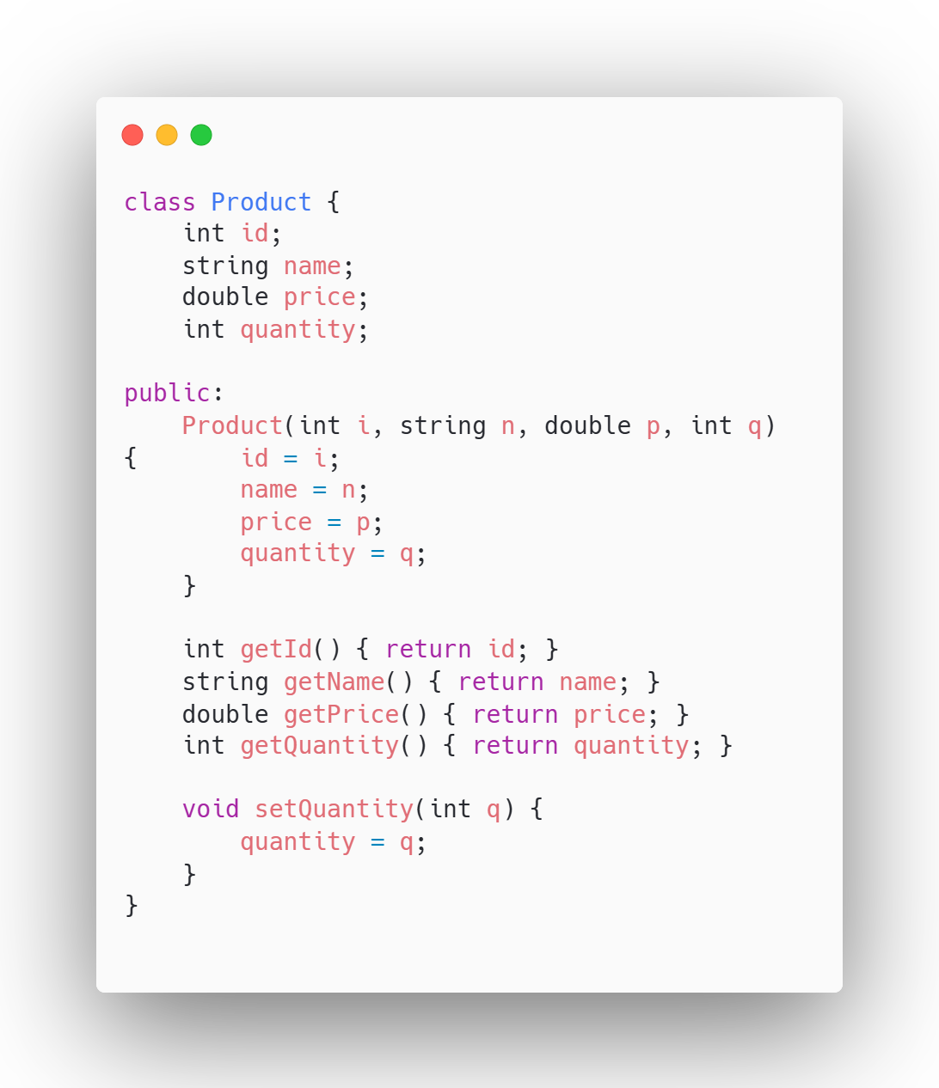
Encapsulation

Slide 8
User
Customer
Admin
Inheritance

Slide 9
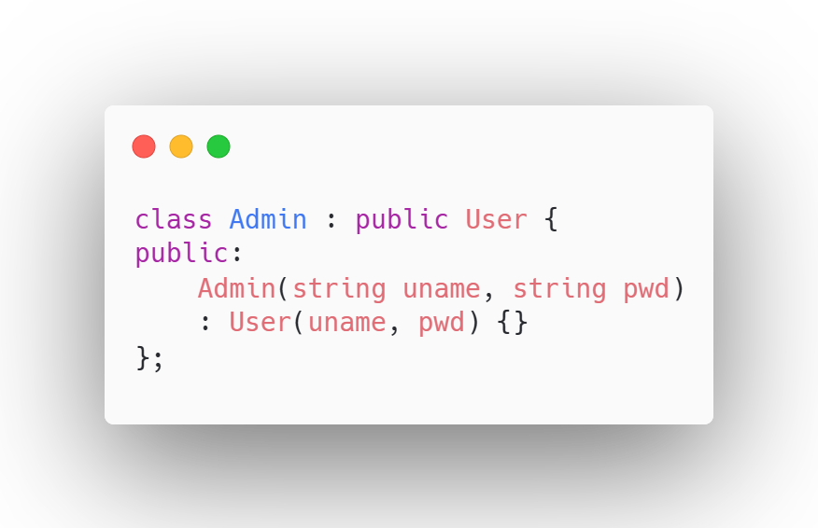
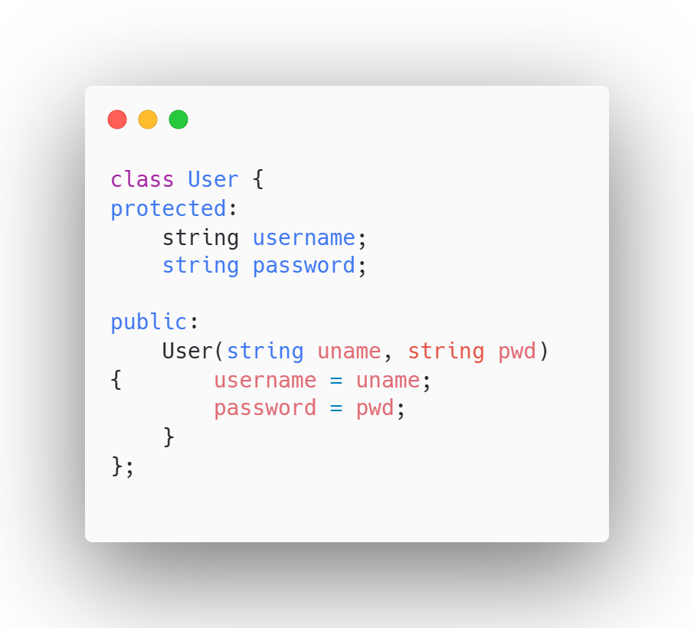
Inheritance

Slide 10
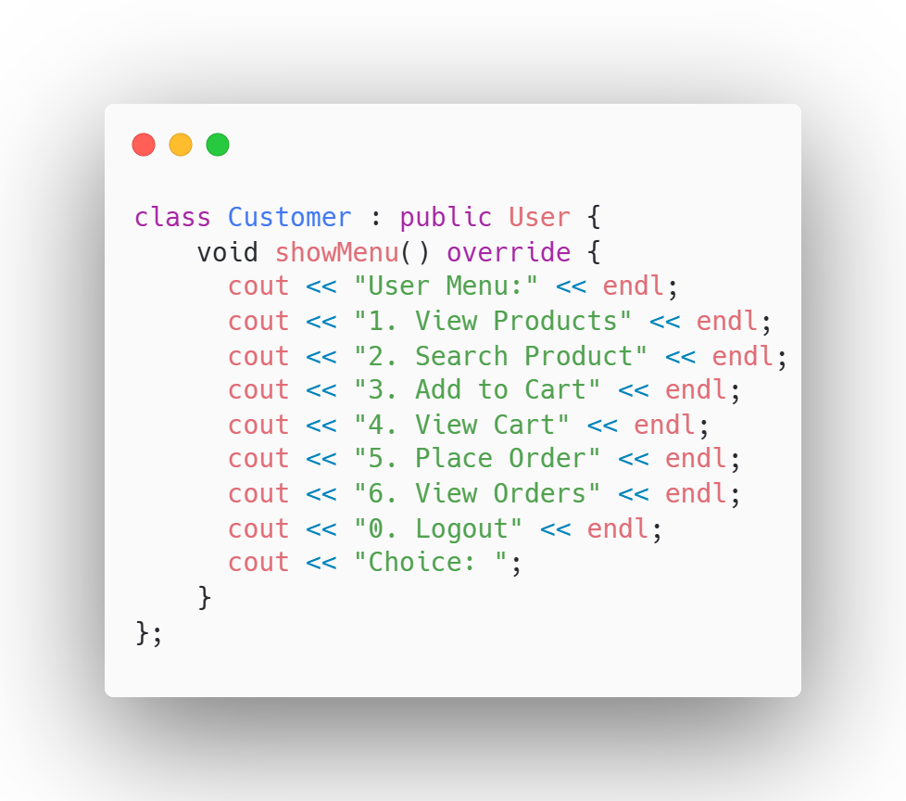
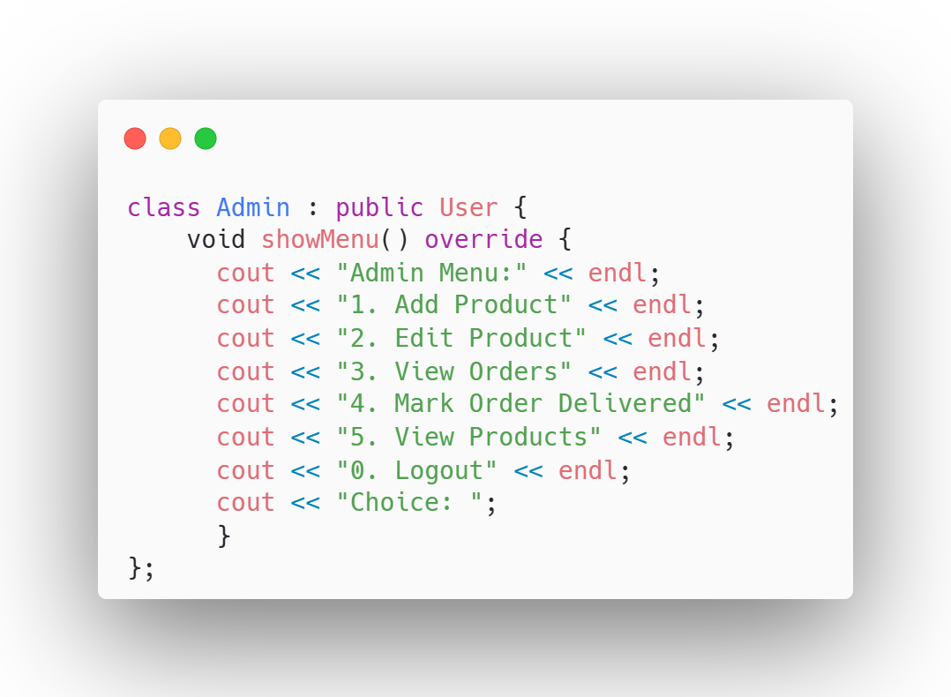
Polymorphism

Slide 11
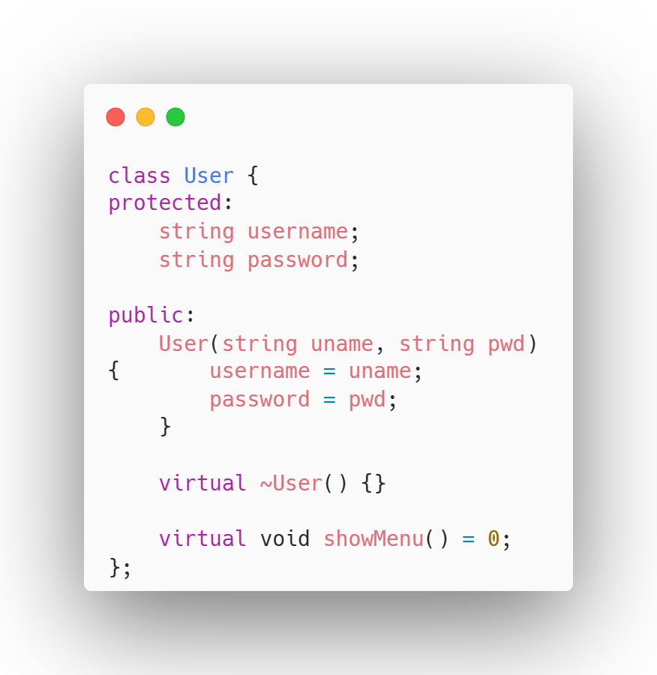
Abstraction

Slide 12
Code structure overview
• Product class: Stores item details • Order class: Tracks orders and their status • User (abstract): Base class for Admin and Customer • Admin class: Add/edit products, view orders • Customer class: Browse, search, order products

Slide 13
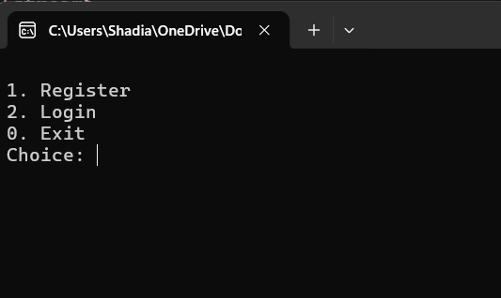
Customer Flow

Slide 14
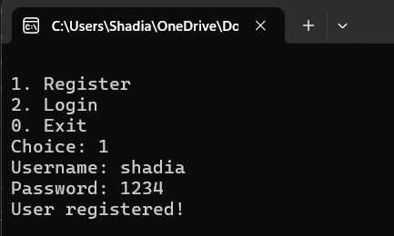
Register

Slide 15
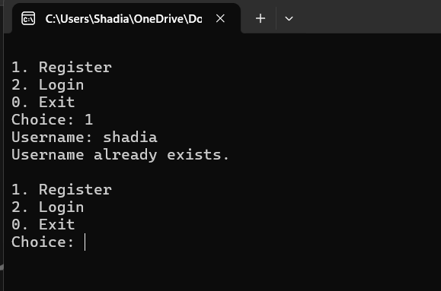
Register

Slide 16
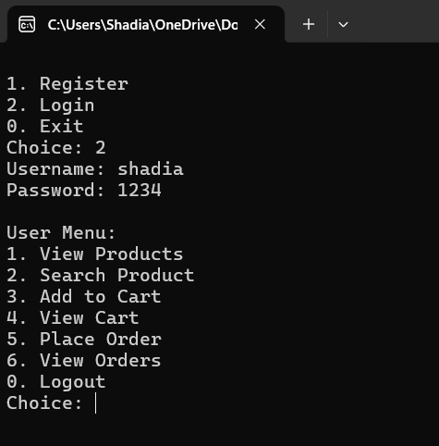
Login

Slide 17
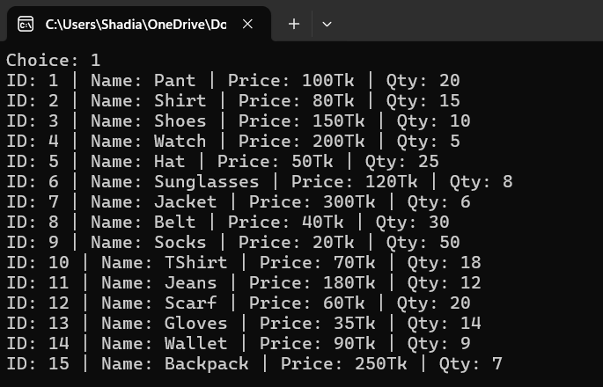
View Product

Slide 18
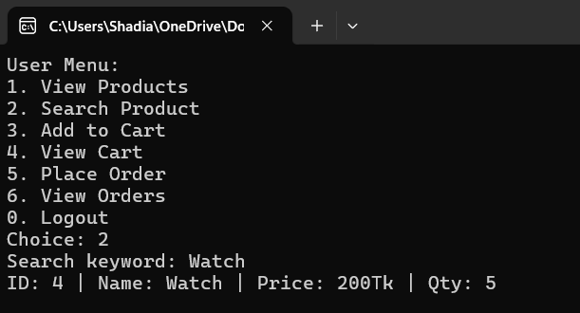
Search Product

Slide 19
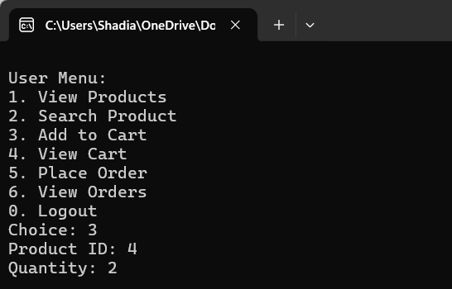
Add to Cart

Slide 20
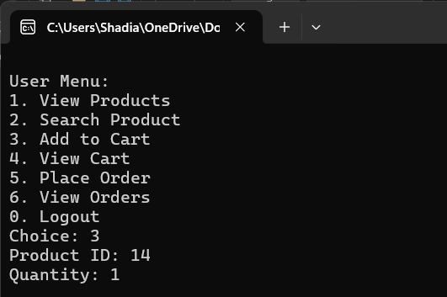
Add to Cart

Slide 21
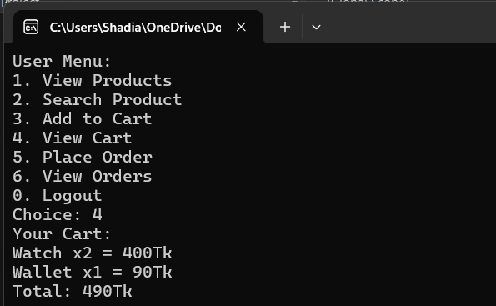
View Cart

Slide 22
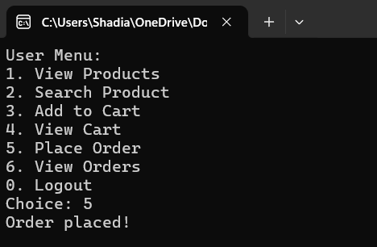
Order

Slide 23
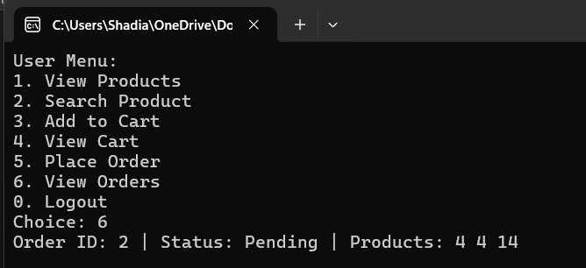
View Orders

Slide 24
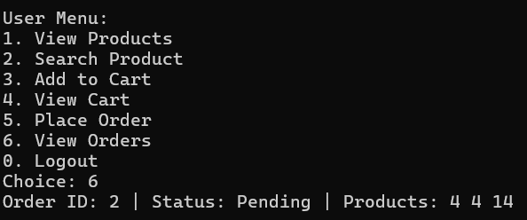
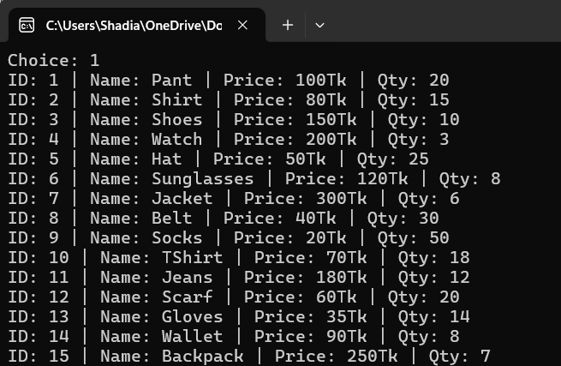
Before
Order
After

Slide 25
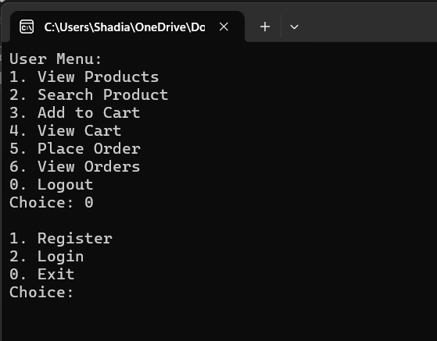
Logout

Slide 26
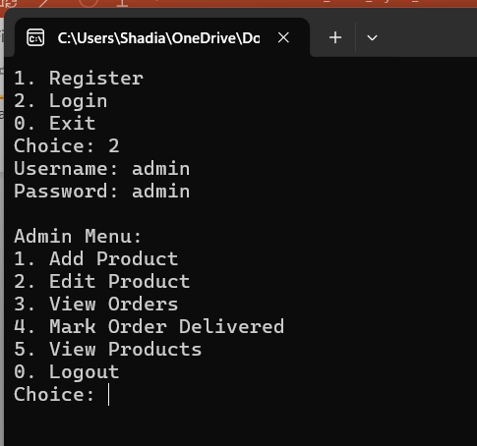
Admin Flow

Slide 27
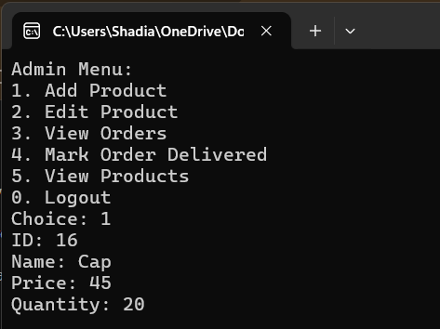
Add Product

Slide 28
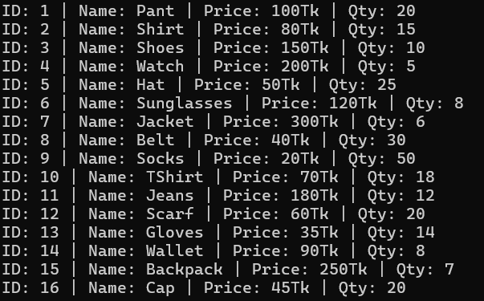
Add Product

Slide 29
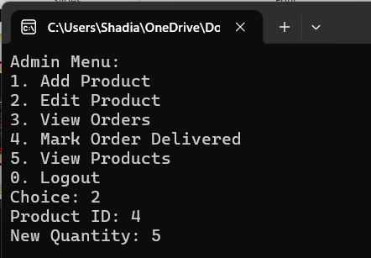
Edit Product

Slide 30
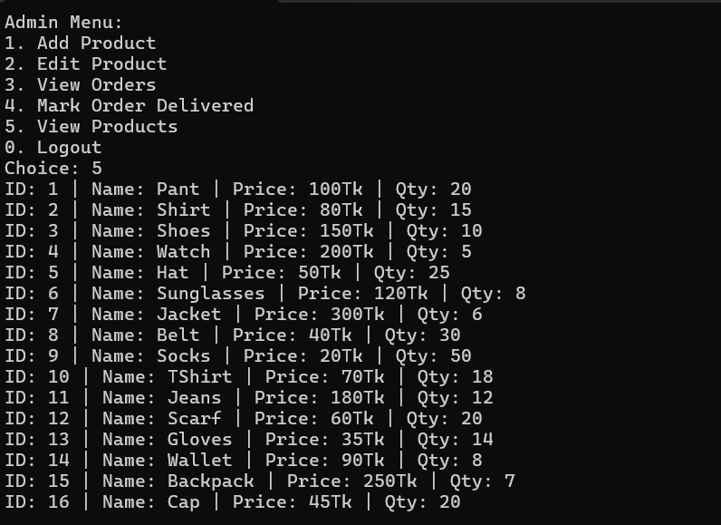
View Products

Slide 31
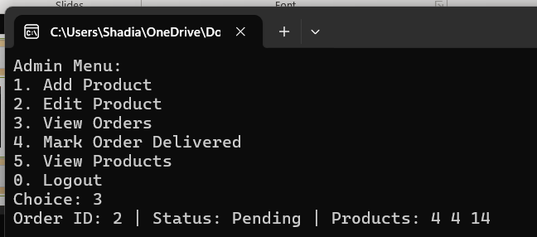
View Orders

Slide 32
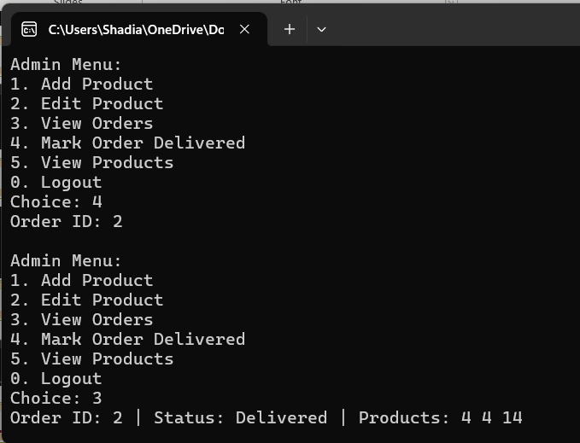
Mark Order Delivered

Slide 33
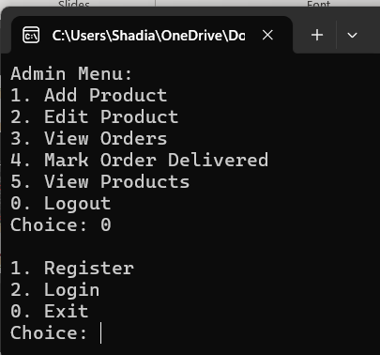
Logout

Slide 34
Result
The application fulfills all requirements for a simple e-commerce system. It demonstrates clean OOP practices and provides a functional shopping experience for customers and management tools for admins.

